Slide 1


Slide 2
Topics in this Chapter…
Advanced Diver Development
Technical Dive Training
Public Safety Dive Training

Slide 3

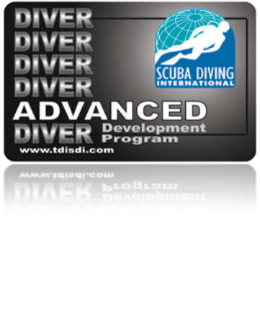

Advanced Diver Development
Many other exciting diving opportunities await after successfully completing your SDI Open Water Scuba Diver course.
You will discover that diving is an adventure that has many different facets.
Enrolling in specialty courses will help you learn how to become a more proficient diver.
Participate in many different types of diving.

Slide 4
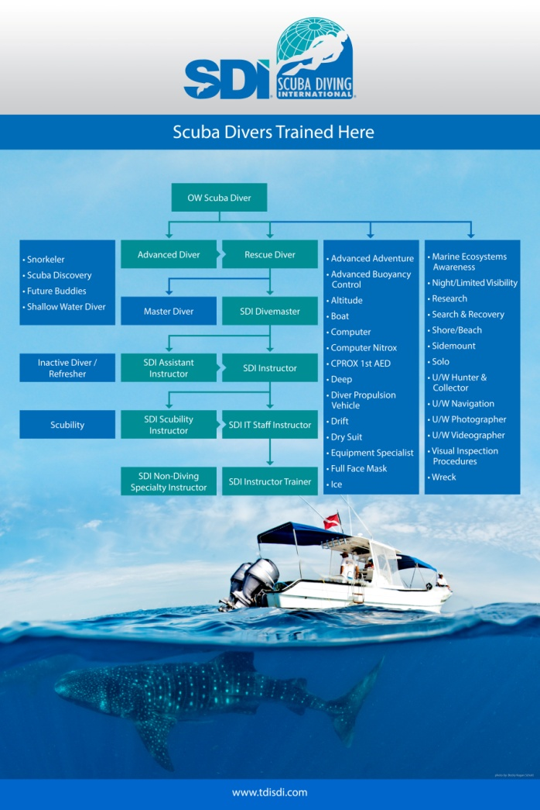
Advanced Diver Development
Your first step in continuing your diving education is to enroll in the SDI Advanced Diver Development program.
Program emphasis
  Instructor directed specialty training
  Self directed experience dives.
Advanced Requirements
  4 Specialties and 25 logged dives.

Slide 5
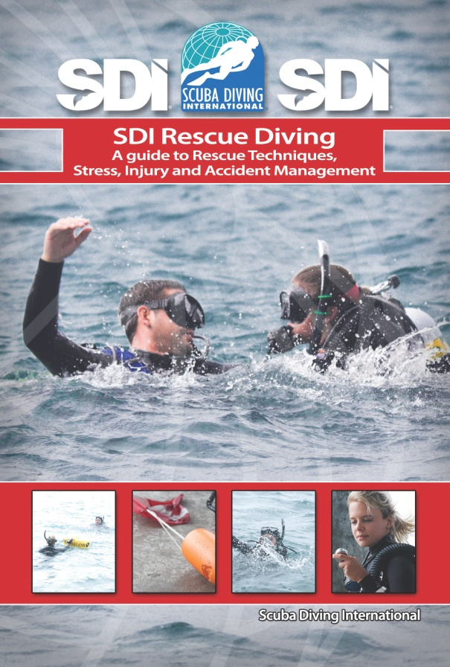
SDI Rescue Diver Course
The SDI Rescue Diver course is designed to develop the knowledge and necessary skills for an individual to:
  Effectively perform diver rescues
  Administer necessary first aid
  Perform self rescues
  Recognize and calm potential panic divers.

Slide 6
SDI Computer Nitrox Diver Course
What is Nitrox?
A breathing gas mixture greater than 21% oxygen found in normal air.
Many divers use Nitrox in place of ordinary compressed air.
  Extend their bottom time.
  Reduce the risk of decompression sickness.

Slide 7
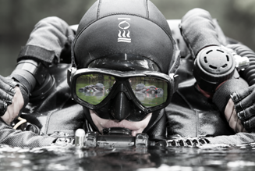
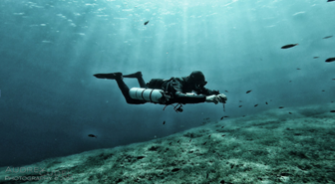
Technical Diving
SDI’s sister company, TDI
  Technical Diving International
What is Technical diving?
  Depths greater than normal sport diving limits.
  Use of Nitrox and other mixed gas.
  Rebreathers.
  Overhead Environments

Slide 8
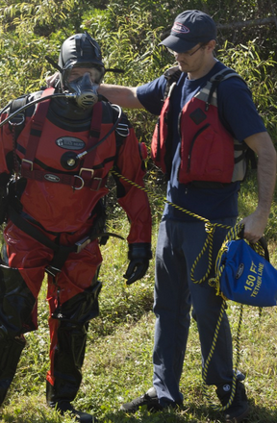
Public Safety Diving
SDI and TDI’s sister company, ERDI
  Emergency Response Diving International, ERDI.
What is Public Safety Diving?
  Police, fire, and federal agencies.
  Crime scene investigation

Slide 9
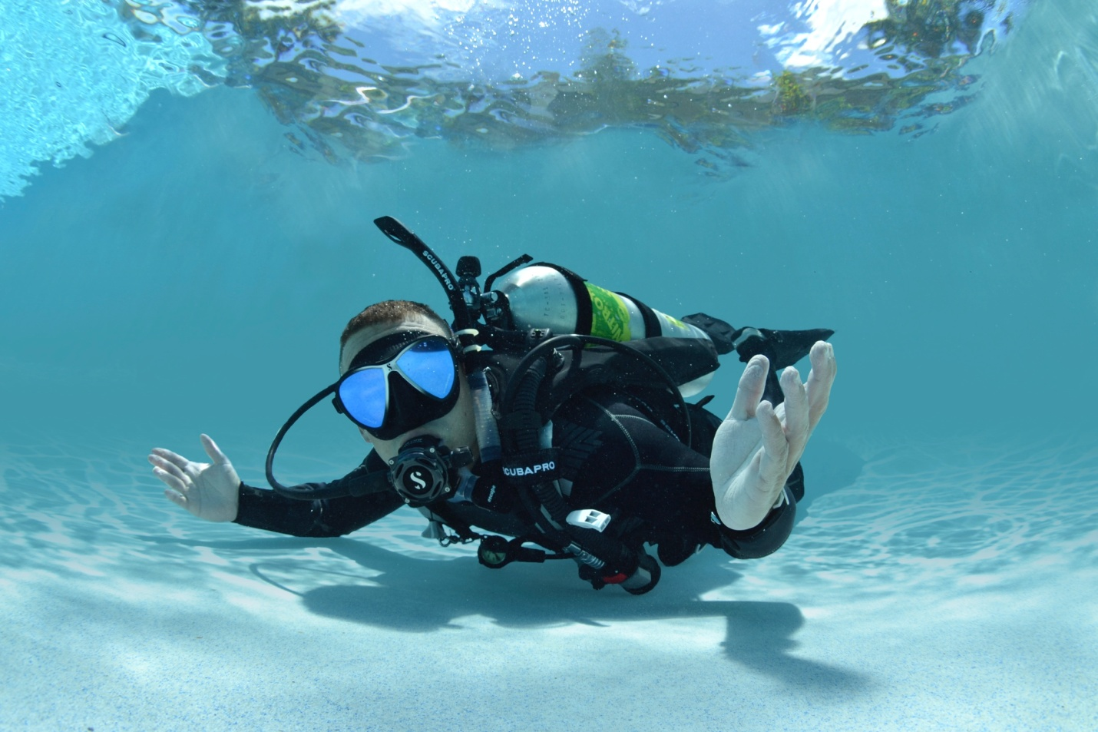
Questions?

